Slide 1


“BUSINESS INSIGHTS 360”
-- Presented by Rayyan Thara

Slide 2
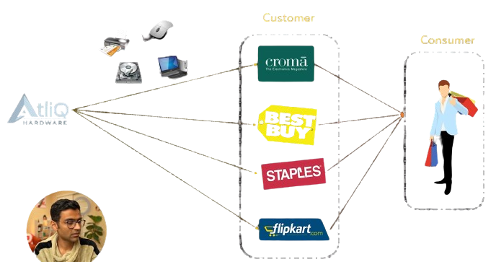

Introducing

Slide 3

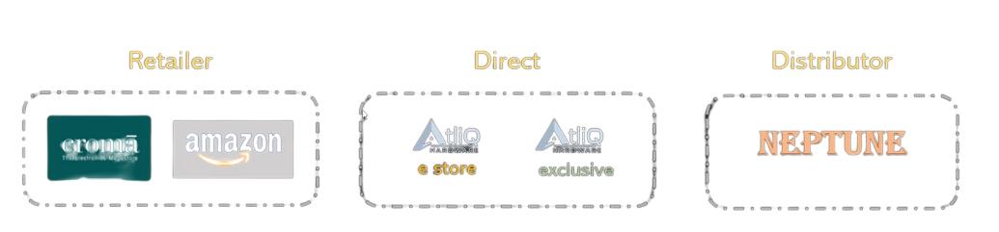
Customers & Channels
CUSTOMERS
CHANNELS

Slide 4

The Problem Statement
Huge loss in Latin America
Data Driven Decisions
Necessity due to Competition

Slide 5

What is “Business Insights 360” ?
Finance
Sales
Marketing
Supply Chain

Slide 6

The Process
- Data Gathering and Preparation (ETL)
- Data Modelling
- DAX Formulas
- Visualizations
- Report Designing

Slide 7

Now Finally,
Business Insights 360

